Slide 1
Generative Adversarial Networks
By: Li min Yan

Slide 2
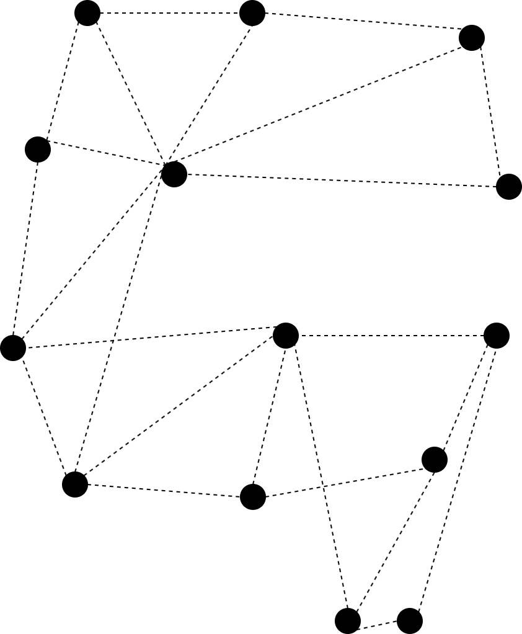
Content
What is GAN？
Why we need GAN？
The problem of GAN
C-GAN&W-GAN

Slide 3
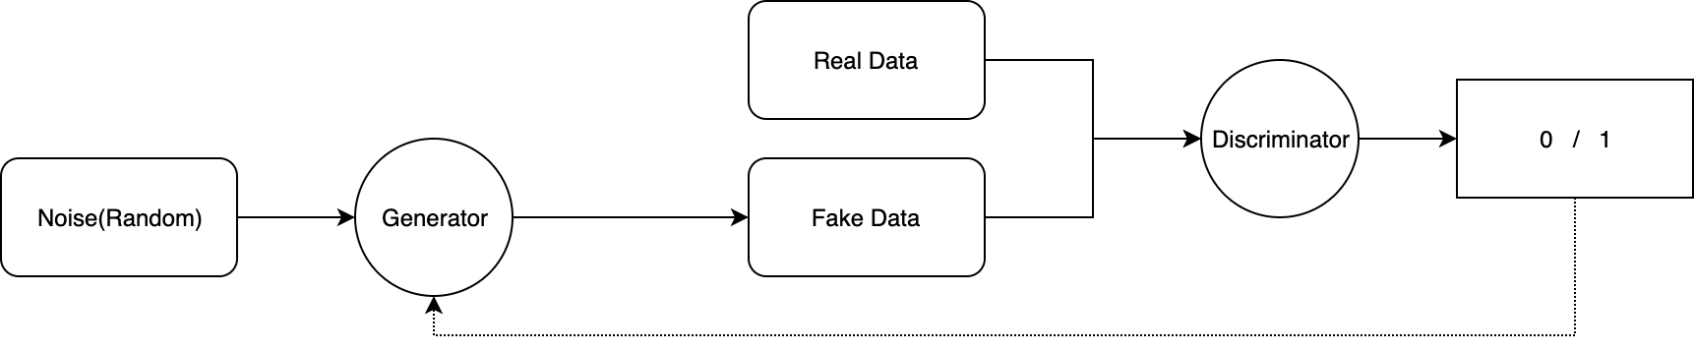
What is GAN？
Generative Adversarial Networks[1]
Generative(Generator)
Adversarial(Discriminator )

Slide 4
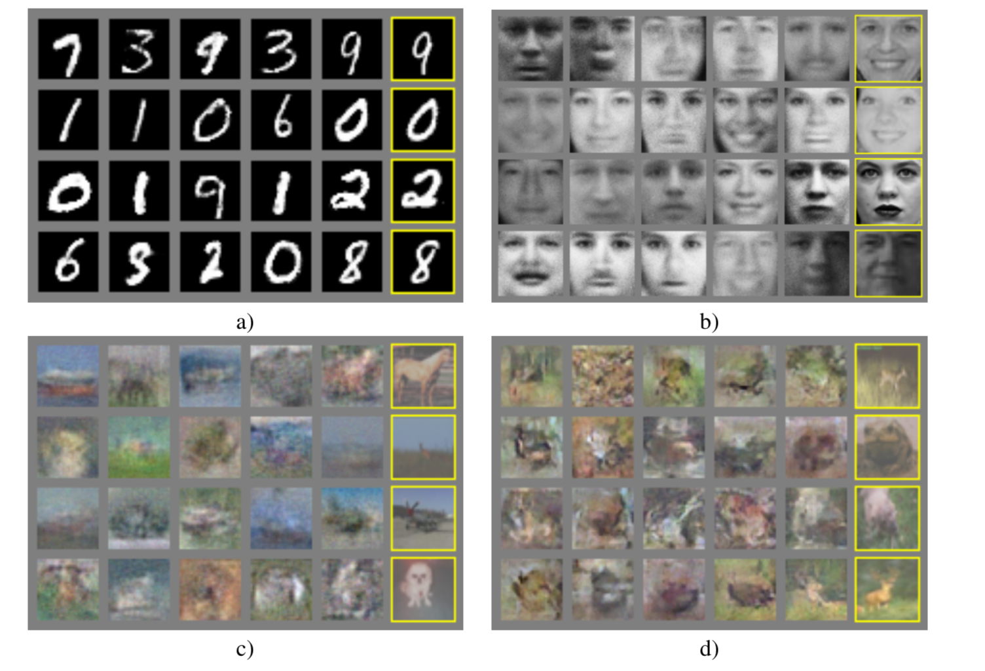
Why we need GAN？
Generating data
Getting more data
Enhancing data
Creating new tings
Generated by GAN [1]

Slide 5
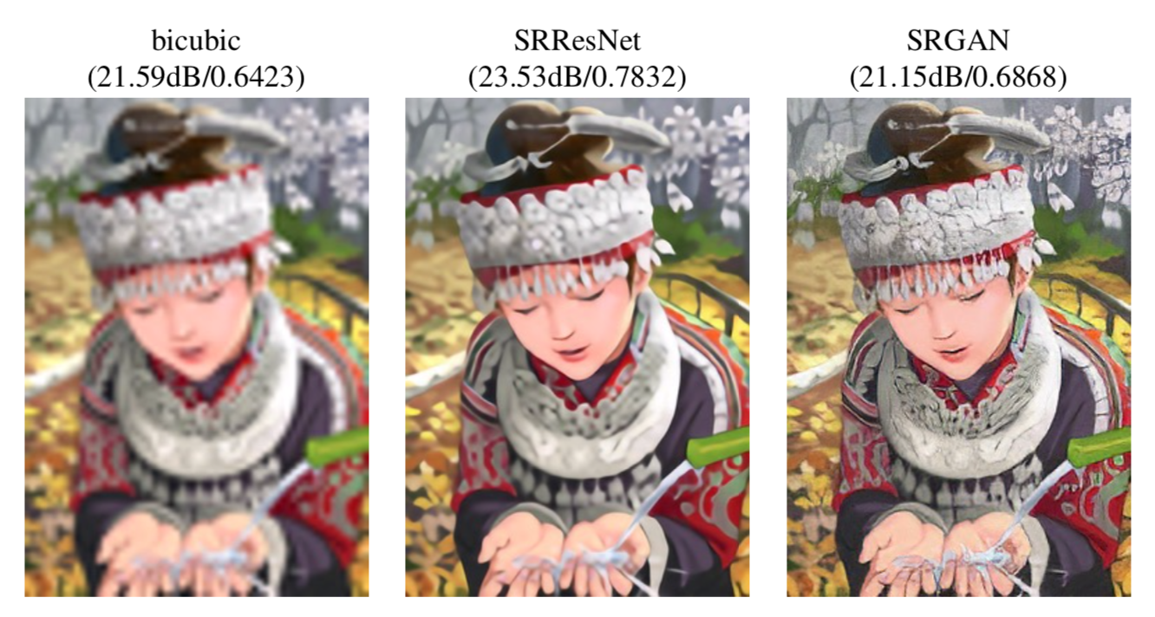
Why we need GAN？
Generating data
Getting more data
Enhancing data
Creating new tings
Super-Resolution use GAN[2]

Slide 6
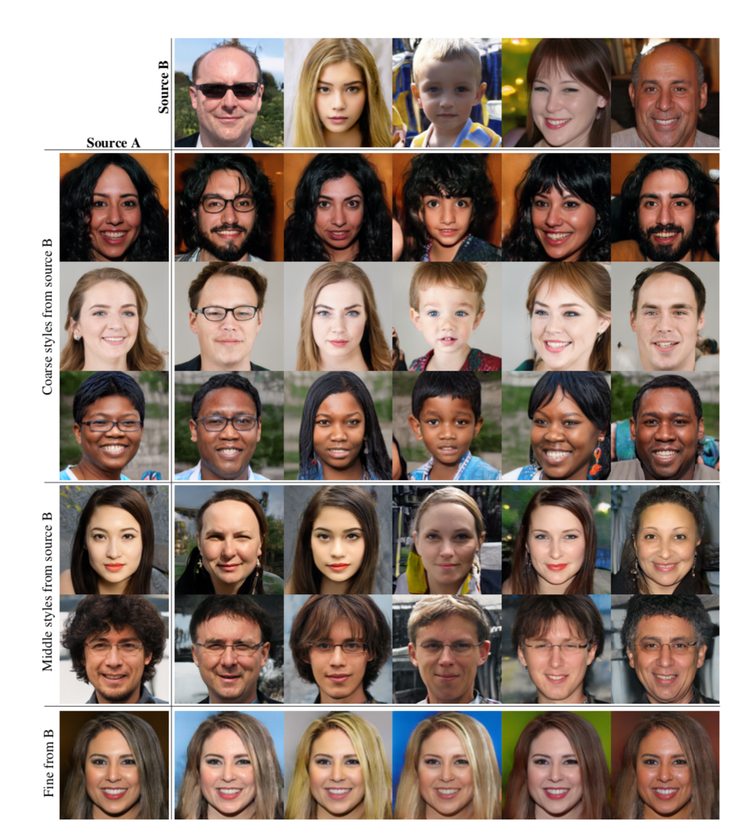
Why we need GAN？
Generating data
Getting more data
Enhancing data
Creating new tings
Style-GAN[3]

Slide 7
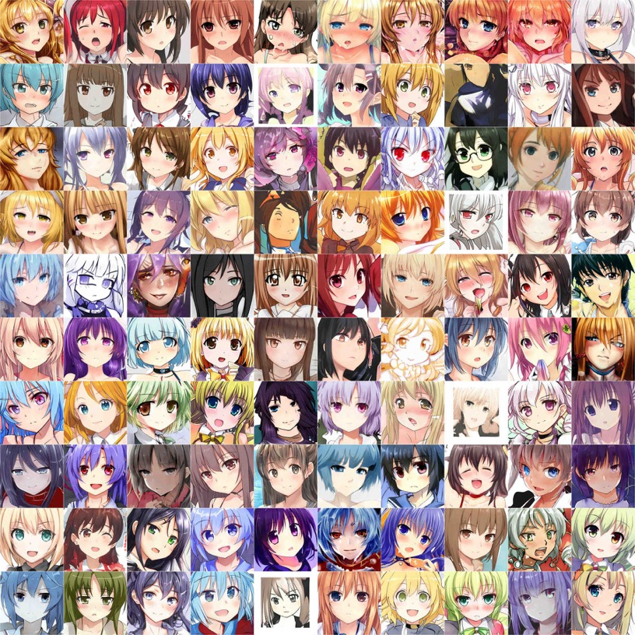
Why we need GAN？
Generating data
Getting more data
Enhancing data
Creating new tings
https://www.thiswaifudoesnotexist.net
This “waifu” does not exist
is available to play
Style-GAN[3]

Slide 8
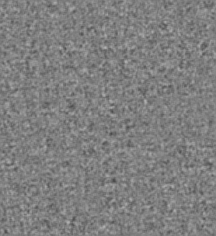
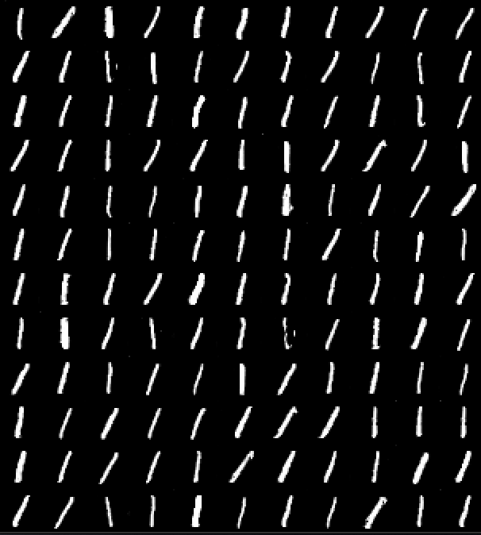
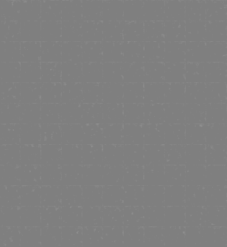
The problem of GAN
Mode collapse[5]
Difficult to train
=
= ?
Mode collapse
Difficult to train

Slide 9
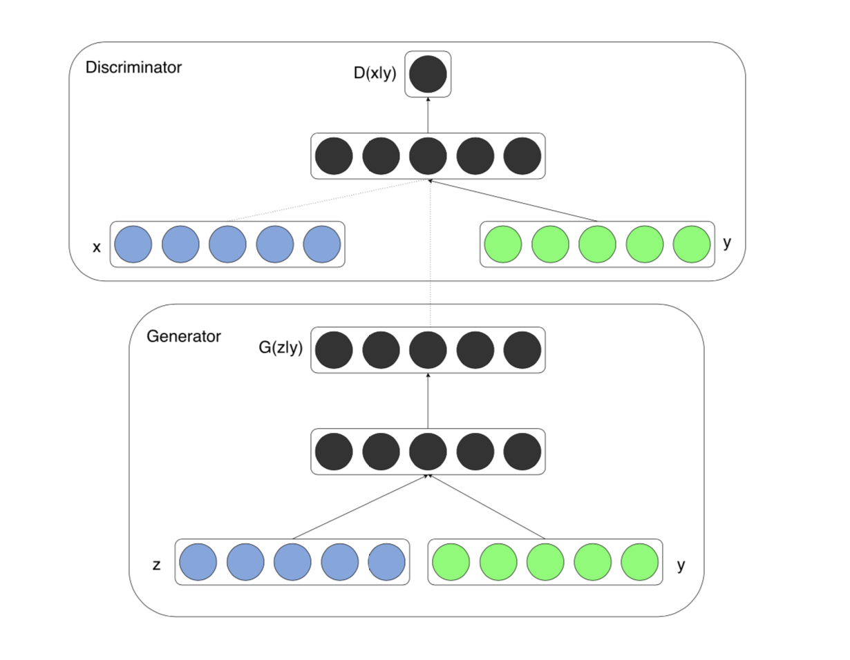
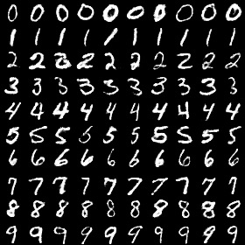
C-GAN&W-GAN
C-GAN [4]
Add condition
W-GAN[5]
Change loss function
C-GAN[4]

Slide 10
Reference
[1]Mehdi Mirza and Simon Osindero. Conditional generative adversarial nets.arXivpreprint arXiv:1411.1784, 2014.
[2]Christian Ledig, Lucas Theis, Ferenc Huszár, Jose Caballero, Andrew Cunningham,Alejandro Acosta, Andrew Aitken, Alykhan Tejani, Johannes Totz, Zehan Wang,et al. Photo-realistic single image super-resolution using a generative adversarialnetwork. InProceedings of the IEEE conference on computer vision and patternrecognition, pages 4681–4690, 2017.
[3]Tero Karras, Samuli Laine, and Timo Aila. A style-based generator architecture forgenerative adversarial networks. InProceedings of the IEEE Conference on ComputerVision and Pattern Recognition, pages 4401–4410, 2019.2
[4]Ian Goodfellow, Jean Pouget-Abadie, Mehdi Mirza, Bing Xu, David Warde-Farley,Sherjil Ozair, Aaron Courville, and Yoshua Bengio. Generative adversarial nets. InAdvances in neural information processing systems, pages 2672–2680, 2014.
[5]Martin Arjovsky, Soumith Chintala, and Léon Bottou. Wasserstein gan.arXivpreprint arXiv:1701.07875, 2017.

